Slide 1
Exception Handling

Slide 2
What are Exceptions?
Exceptions are events that occur during the execution of a program that disrupt the normal flow of instructions.
They can occur due to various reasons, such as invalid inputs, file not found, network errors, etc.
Python provides a robust exception handling mechanism to handle these exceptional situations.

Slide 3
The try-except Block
The try-except block is used to catch and handle exceptions.
The code that may raise an exception is placed inside the try block.
The handling code is written in the except block.

Slide 4
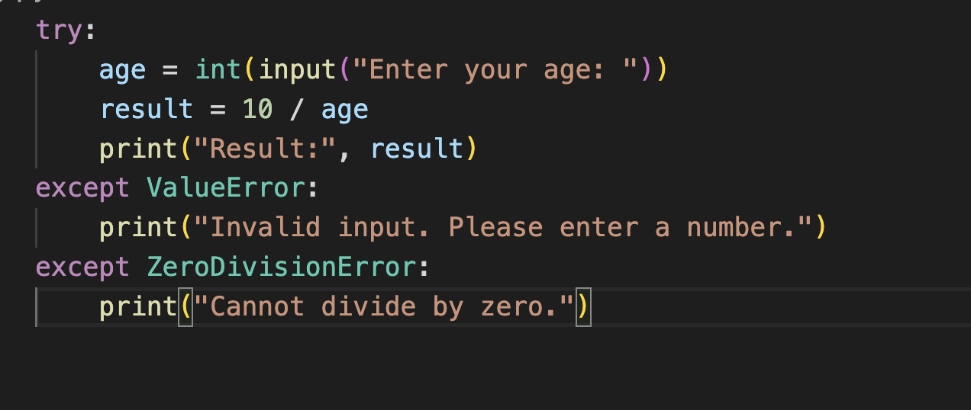

Slide 5
Handling Multiple Exceptions
You can handle multiple exceptions using multiple except blocks.
Each except block handles a specific exception type.

Slide 6
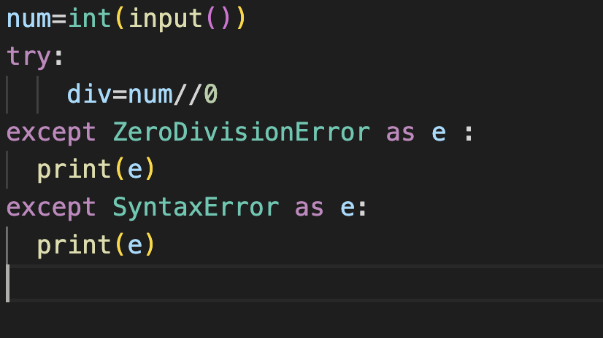

Slide 7
The else block
The else block is executed if no exceptions are raised in the try block.
It is generally used to handle code that should run only when no exceptions occur.

Slide 8
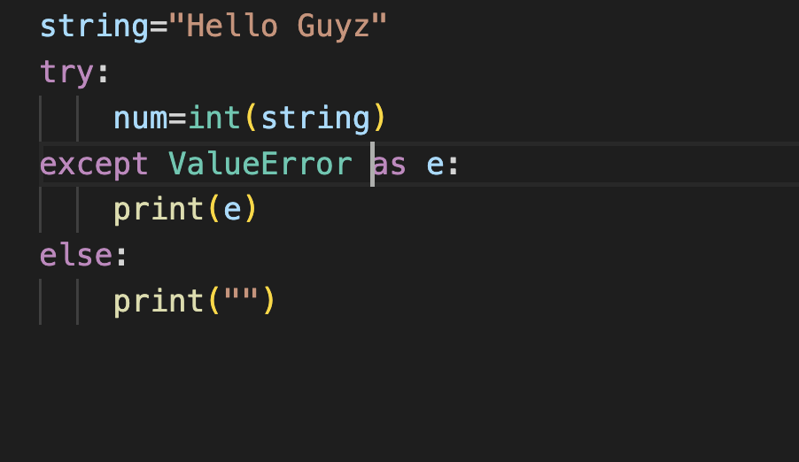
The else block Syntax

Slide 9
The finally block
The finally block is executed regardless of whether an exception occurred or not.
It is used to perform cleanup actions, such as closing files or releasing resources.

Slide 10
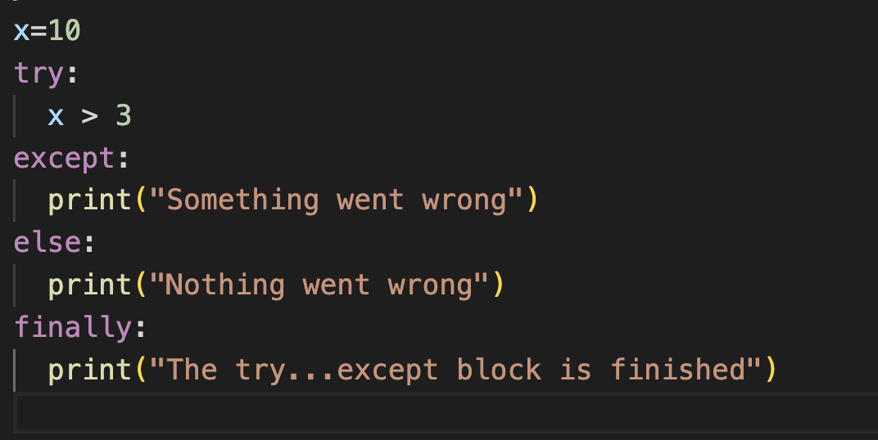
The finally block syntax

Slide 11
Raising Exceptions
You can raise exceptions manually using the raise statement.
This allows you to control the flow of your program based on specific conditions.

Slide 12
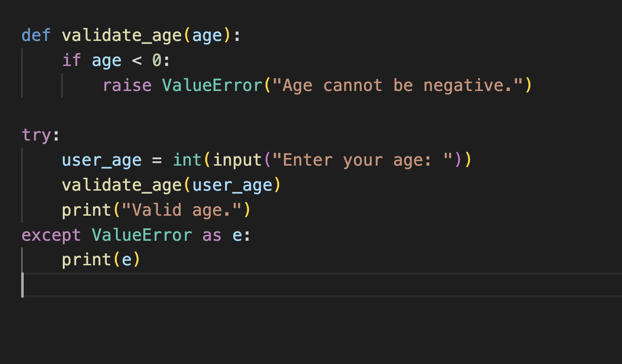
Raising Exceptions Syntax

Slide 13
Conclusion
Exception handling is an essential part of writing robust and error-tolerant Python programs.
Use try-except blocks to catch and handle exceptions.
The else block can be used to handle code that should run when no exceptions occur.
The finally block is used for cleanup actions.
You can raise exceptions manually using the raise statement.

